Slide 1
Technology Refresh Program
Summer 2014
Mapping CSG Resources and Capabilities
Enhancing Quality of Services
Enhancing Solutions Capability

Slide 2
Quality of Service
Incident Response
Deployment Speed
Service Availability
Service Latency
Service Reliability
Service Security
Issue Tracking
Version Control
Integrated Testing
Availability Monitoring
Continuous Deployment
Secure Development

Slide 3
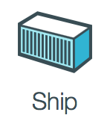
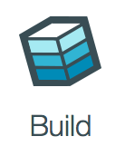


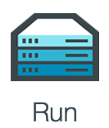
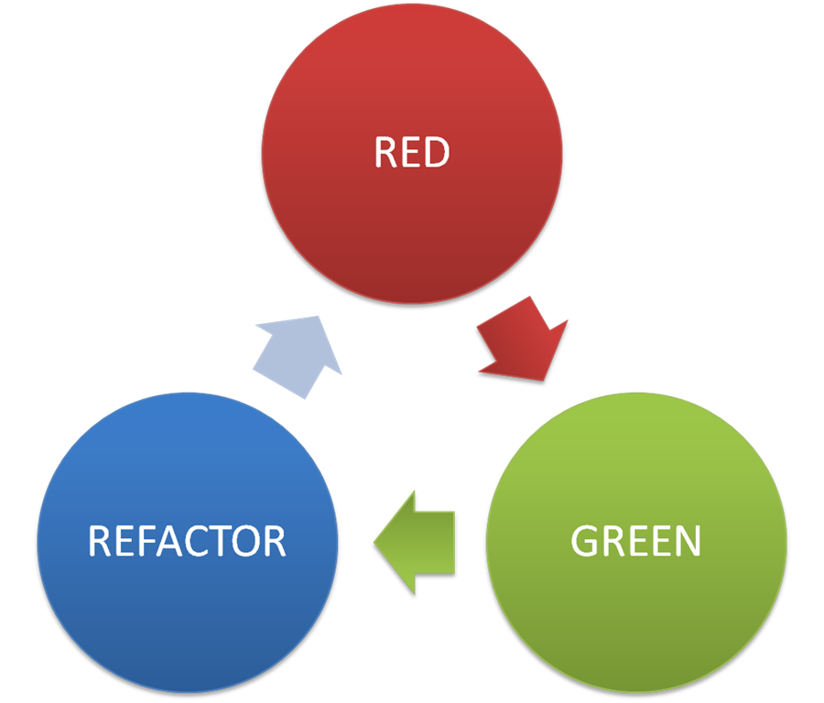
Start
Test
Develop
Refactor

Slide 4
Solutions Capability
Needs Assessment
Identifying IT Weaknesses
Identifying Potential Bottlenecks
Identifying Future Candidates
Testing Regimen
Test Driven Development
Continuous Integration
Behavior Driven Development
Platform Awareness
Programming Languages
Development Paradigms
Solution Architectures
Continuous Deployment
Canisterized Deployment
DevOps Paradigm
New Solutions
Solution Ideation
Prototyping
Continuous Learning
Dev Community Awareness
Online Learning Tools
Workshops and Seminars
Development
Operations
Process Maturity
Continuous Learning

Slide 5
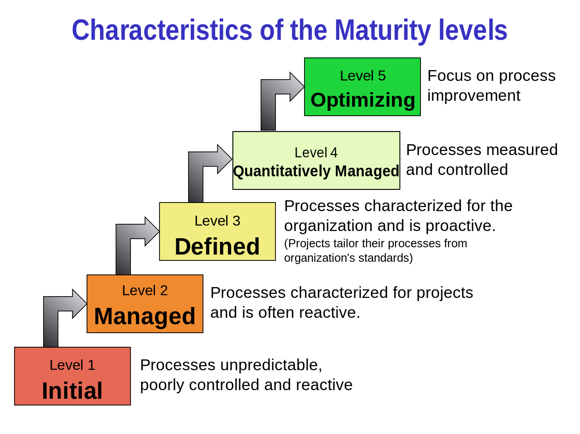
https://en.wikipedia.org/wiki/Capability_Maturity_Model_Integration

